Slide 1

cv
Efficient Algorithmic models for Adversarial attacks and Defenses in Deep learning
Phase II - Review 1
Team Members
1. Durgesh Nandini M [1DS19CS711]
2. Gagandeep B K [1DS19CS714]
3. Gaurav Sarkar [1DS19CS715]
4. Faizan Khurshid [1DS19CS713]
Under the Guidance of
Mrs. Sarala DV Assistant Professor, Dept of Computer Science and Engineering
Department of Computer Science & Engineering, DSCE

Slide 2
INTRODUCTION TO THE PROBLEM:
With the rapid developments of artificial intelligence (AI) and deep learning (DL) techniques, it is critical to ensure the security and robustness of the deployed algorithms.
Adversaries can easily fool DL models by perturbing benign samples without being discovered by humans.
Perturbations that are imperceptible to human vision/hearing are sufficient to prompt the model to make a wrong prediction with high confidence.
Thus adversarial sample is considered to be a significant obstacle to the mass deployment of DL models that are in production.
There are a number of attack algorithms for generating adversarial samples, and a number of defense mechanisms for providing protection against adversarial attacks and making the models more robust and secure.
Department of Computer Science & Engineering, DSCE

Slide 3
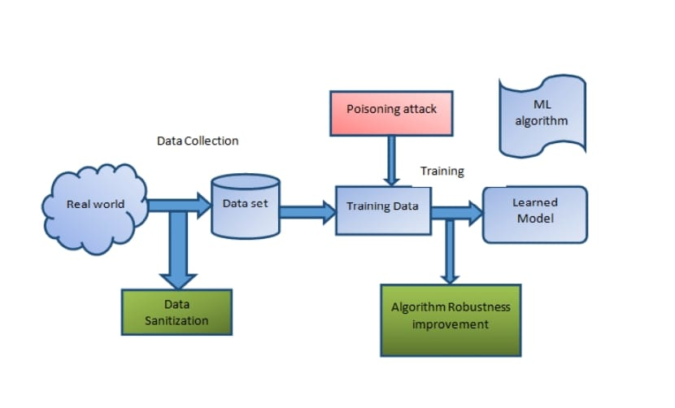
SYSTEM DIAGRAM / DESIGN :
Department of Computer Science & Engineering, DSCE

Slide 4
Modules
Adversarial-robustness-toolbox
from art.attacks.evasion
from art.defences.preprocessor
from torchattacks import PGD
torchattacks.FGSM
fb.attacks.LinfFastGradientAttack
torchattacks.PGDL2

Slide 5
Modules Descriptions
Adversarial-robustness-toolbox
The Adversarial Robustness Toolbox (ART) is an open-source Python library for machine learning security. The toolbox provides a comprehensive set of tools for creating and evaluating adversarial attacks and defenses in the context of deep learning models.
ART includes a range of adversarial attack techniques, such as FGSM, DeepFool, and Carlini-Wagner attacks, as well as various defense mechanisms, such as adversarial training, feature squeezing, and input transformations.
Art.attacks.evasion
It includes implementations of various evasion attacks that aim to fool machine learning models by modifying input data.
These attacks can be used to generate adversarial examples, which are inputs that have been intentionally perturbed to cause a machine learning model to misclassify them.
Art.defences.preprocessor
It contains a collection of preprocessing techniques that can be used to enhance the robustness of machine learning models against adversarial attacks.
Preprocessing refers to the manipulation of input data before it is fed into a machine learning model. The goal of preprocessing is to improve the quality of the data and reduce the risk of errors or biases in the model's predictions.

Slide 6
torchattacks
The torchattacks library contains implementations of several popular attack methods, including Fast Gradient Sign Method (FGSM), Projected Gradient Descent (PGD), Carlini and Wagner (C&W) attack, and more.
It also includes various defenses that can be applied to protect neural networks from adversarial attacks, such as adversarial training and randomization.
torchattacks.FGSM
It provides a convenient way to generate adversarial examples using the FGSM attack. It takes as input a PyTorch model, an input image, a target label (if applicable), and an epsilon value.
It then calculates the gradient of the loss function with respect to the input, adds the perturbation to the input image, and returns the perturbed image as the adversarial example.
torchattacks.PGDL2
The PGD L2 attack is a popular adversarial attack used to generate adversarial examples. Given an input image and a target class, the attack algorithm adds a small perturbation to the input image to cause a misclassification by the target model.
The module takes in a PyTorch model, an input image, the true label of the image, and a target label (if targeted attack is desired) as inputs and returns an adversarial example that causes misclassification.

Slide 7
Datasets:
CIFAR-10
The CIFAR-10 dataset is a collection of 60,000 32x32 color images in 10 classes, with 6,000 images per class. The classes include airplane, automobile, bird, cat, deer, dog, frog, horse, ship, and truck.
The dataset is commonly used for image classification tasks and serves as a benchmark for evaluating the performance of machine learning algorithms.
MNIST
It consists of 70,000 grayscale images of handwritten digits (0-9), each of size 28x28 pixels. The dataset is split into a training set of 60,000 images and a test set of 10,000 images.
The goal of using this dataset is to train a model to accurately recognize the digits in the images, making it a popular benchmark for evaluating the performance of machine learning algorithms.
Department of Computer Science & Engineering, DSCE

Slide 8
ImageNet
It is a large-scale image dataset that contains over 1.2 million images with 1000 categories.
It was created for the purpose of advancing computer vision research and is commonly used as a benchmark for object recognition and image classification tasks.
Clarifai
It consists of images and associated labels, which are used to train these models.
The Clarifai dataset is used to train models for a variety of applications, such as object recognition, facial recognition, and text recognition in images.
Department of Computer Science & Engineering, DSCE

Slide 9
ALGORITHM:
Fast Gradient Method
The Fast Gradient Method (FGM) is a technique used in the field of adversarial machine learning to generate adversarial examples.
The FGM works by taking the gradient of the loss function with respect to the input data, and then perturbing the input data in the direction of the gradient to generate an adversarial example. This technique is called "fast" because it is computationally efficient, and it is also very effective at generating adversarial examples that can fool machine learning models.
from art.attacks.evasion import FastGradientMethod adv = FastGradientMethod(estimator=classifier, eps=5) x_art_adv = adv.generate(x_art) pred_adv = classifier.predict(x_art_adv) label_adv = np.argmax(pred_adv, axis=1)[0] confidence_adv = pred_adv[:, label_adv][0] print('Prediction:', label_to_name(label_adv), '- confidence {0:.2f}'.format(confidence_adv))
Department of Computer Science & Engineering, DSCE

Slide 10
Project Gradient Method
Project gradient descent is an important optimization algorithm in machine learning and is used in a variety of models, including linear regression, logistic regression, and neural networks.
In project gradient descent, the goal is to minimize the cost function not just for a single data point, but for an entire dataset.
adv = ProjectedGradientDescent(classifier, targeted=False, max_iter=2, eps_step=1, eps=4) # Low max_iter = 2, eps = 4 # Middle max_iter = 3, eps = 8 # High max_iter = 10, eps = 8 # Generate the adversarial sample: x_art_adv = adv.generate(x_art) # Plot the adversarial sample (note: we swap color channels back to RGB order): # plt.figure(figsize=(8,8)); plt.imshow(x_art_adv[0] / 255); plt.axis('off'); plt.show() # And apply the classifier to it: pred_adv = classifier.predict(x_art_adv) label_adv = np.argmax(pred_adv, axis=1)[0] confidence_adv = pred_adv[:, label_adv][0] print('Prediction:', label_to_name(label_adv), '- confidence {0:.2f}'.format(confidence_adv))
Department of Computer Science & Engineering, DSCE

Slide 11
Basic Iterative Method
The BIM algorithm starts with an initial input image and then iteratively perturbs it by taking a small step in the direction of the gradient of the loss function with respect to the input image. The perturbation size is typically chosen to be small to ensure that the perturbed image remains visually similar to the original image.
After each iteration, the perturbed image is clipped to ensure that it remains within a valid range of pixel values, and is then used as the starting point for the next iteration. This process is repeated for a specified number of iterations or until the desired level of adversarial perturbation is achieved.
from art.attacks.evasion import BasicIterativeMethod adv = BasicIterativeMethod(estimator=classifier, targeted=False, eps=5, max_iter=50, eps_step=1) x_art_adv = adv.generate(x_art) pred_adv = classifier.predict(x_art_adv) label_adv = np.argmax(pred_adv, axis=1)[0] confidence_adv = pred_adv[:, label_adv][0] print('Prediction:', label_to_name(label_adv), '- confidence {0:.2f}'.format(confidence_adv))
Department of Computer Science & Engineering, DSCE

Slide 12
Spatial smoothing
Spatial smoothing is a technique used in adversarial defense to increase the robustness of a deep learning model against adversarial attacks.
It involves smoothing the input image by applying a low-pass filter, such as a Gaussian filter, which blurs the image and reduces the high-frequency noise.
ss = SpatialSmoothing(window_size=3)
x_art_def, _ = ss(x_art) x_art_adv_def, _ = ss(x_art_adv)
pred_def = classifier.predict(x_art_def) label_def = np.argmax(pred_def, axis=1)[0] confidence_def = pred_def[:, label_def][0] pred_adv_def = classifier.predict(x_art_adv_def) label_adv_def = np.argmax(pred_adv_def, axis=1)[0] confidence_adv_def = pred_adv_def[:, label_adv_def][0]
Department of Computer Science & Engineering, DSCE

Slide 13
Gaussian Augmentation
Gaussian Augmentation is a technique used in adversarial defense to improve the robustness of machine learning models against adversarial attacks.
The idea behind Gaussian Augmentation is to add random noise to the input data during the training process, which makes the model more resistant to small perturbations in the input
gda = GaussianAugmentation(sigma=9, augmentation=False)
x_art_gda_def, _ = gda(x_art) x_art_adv_gda_def, _ = gda(x_art_adv)
pred_gda_def = classifier.predict(x_art_gda_def) label_gda_def = np.argmax(pred_gda_def, axis=1)[0] confidence_gda_def = pred_gda_def[:, label_gda_def][0] pred_adv_gda_def = classifier.predict(x_art_adv_gda_def) label_adv_gda_def = np.argmax(pred_adv_gda_def, axis=1)[0] confidence_adv_gda_def = pred_adv_gda_def[:, label_adv_gda_def][0]
Department of Computer Science & Engineering, DSCE

Slide 14
Feature squeezing
Feature squeezing is an adversarial defense technique that reduces the search space for an attacker by altering the input features of a machine learning model.
The basic idea is to map multiple similar inputs into the same output, making it more difficult for an attacker to generate a successful attack
fs = FeatureSqueezing(bit_depth=3, clip_values=(0, 255))
In [ ]:
x_art_fs_def, _ = fs(x_art) x_art_adv_fs_def, _ = fs(x_art_adv)
In [ ]:
pred_fs_def = classifier.predict(x_art_fs_def) label_fs_def = np.argmax(pred_fs_def, axis=1)[0] confidence_fs_def = pred_fs_def[:, label_fs_def][0] pred_adv_fs_def = classifier.predict(x_art_adv_fs_def) label_adv_fs_def = np.argmax(pred_adv_fs_def, axis=1)[0] confidence_adv_fs_def = pred_adv_fs_def[:, label_adv_fs_def][0]
Department of Computer Science & Engineering, DSCE

Slide 15
Co-Guide Meet Details
10/1/23 - first co-guide meet
Remarks by the co-guide : Looks good so far. Come up with design for the project.
30/1/23 - second co-guide meet
Remarks by the co-guide : Looks good so far. Start with the implementation for the image data model.
11/4/23 - third co-guide meet
Remarks by the co-guide : Looks good so far. Start with the implementation for the text data model.

Slide 16
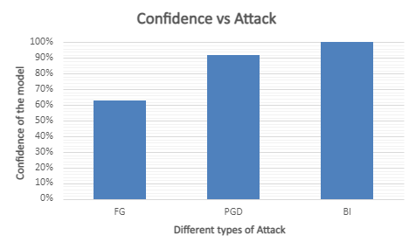
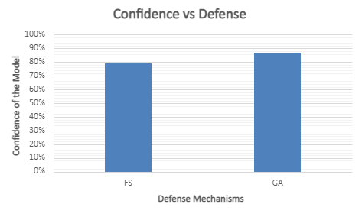
Result :
Department of Computer Science & Engineering, DSCE

Slide 17


Result :
Department of Computer Science & Engineering, DSCE

Slide 18

PROJECT TOOL SNAPSHOT:
Department of Computer Science & Engineering, DSCE

Slide 19
cv
Batch No : 68
Team Member 1 : Gaurav Sarkar 1DS19CS715 Contribution : Implemented adversarial attacks on image data model | Team Member 2 : Durgesh Nandini M 1DS19CS711 Contribution : Implemented adversarial attacks on image data model
Team Member 3 : GaganDeep 1DS19CS714 Contribution : Implemented defenses on image data model | Team Member 4 : Faizan khurshid 1DS19CS713 Contribution : Implemented defenses on image data model
Department of Computer Science & Engineering, DSCE

